Slide 1
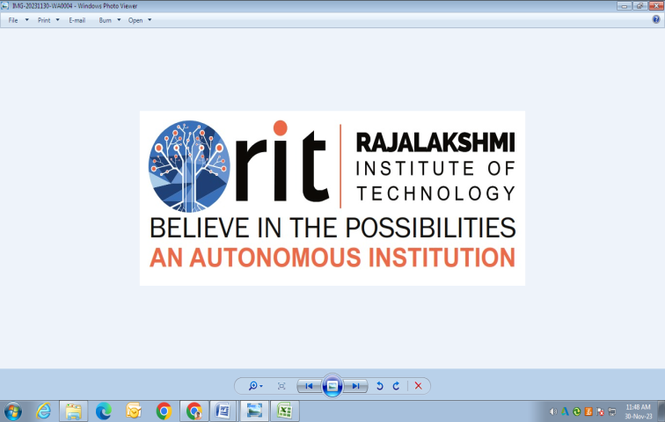
DEPARTMENT OF CSE (ARTIFICIAL INTELLIGENCE AND MACHINE LEARNING) ACADEMIC YEAR 2025 - 2026 SEMESTER III ARTIFICIAL INTELLIGENCE LABORATORY MINI PROJECT REVIEW <TITLE OF THE PROJECT>
REGISTER NUMBER | 2117240030048
NAME | Inas Husayn K
YEAR | 2nd Year
SECTION | AIML-A
FACULTY IN-CHARGE | Mrs. M. Divya

Slide 2
PROBLEM STATEMENT
In today’s digital era, users expect instant communication and automated assistance on websites and applications. Many small businesses, educational portals, and service providers cannot afford complex AI systems or paid chatbot platforms. Hence, there is a need for a simple, cost-effective chatbot system that can provide basic automated responses to user queries through a web interface — built using Python (Flask) and simple web technologies (HTML, CSS, and Python).

Slide 3
THEORETICAL BACKGROUND
A chatbot (also known as a conversational agent) is a computer program designed to simulate conversation with human users, especially over the Internet. It processes user inputs in natural language and generates automated responses that attempt to mimic human conversation. Chatbots are widely used in various applications such as customer service, education, entertainment, and information retrieval.

Slide 4
IMPLEMENTATION AND CODE
Link to code in Git-hub Repository
List | Git-hub Repository Links
Implementation of Code Link | https://github.com/Inas-k/aiminiproject1
Word Document Report Link | https://github.com/Inas-k/aiminiproject1
PPT Link | https://github.com/Inas-k/aiminiproject1

Slide 5
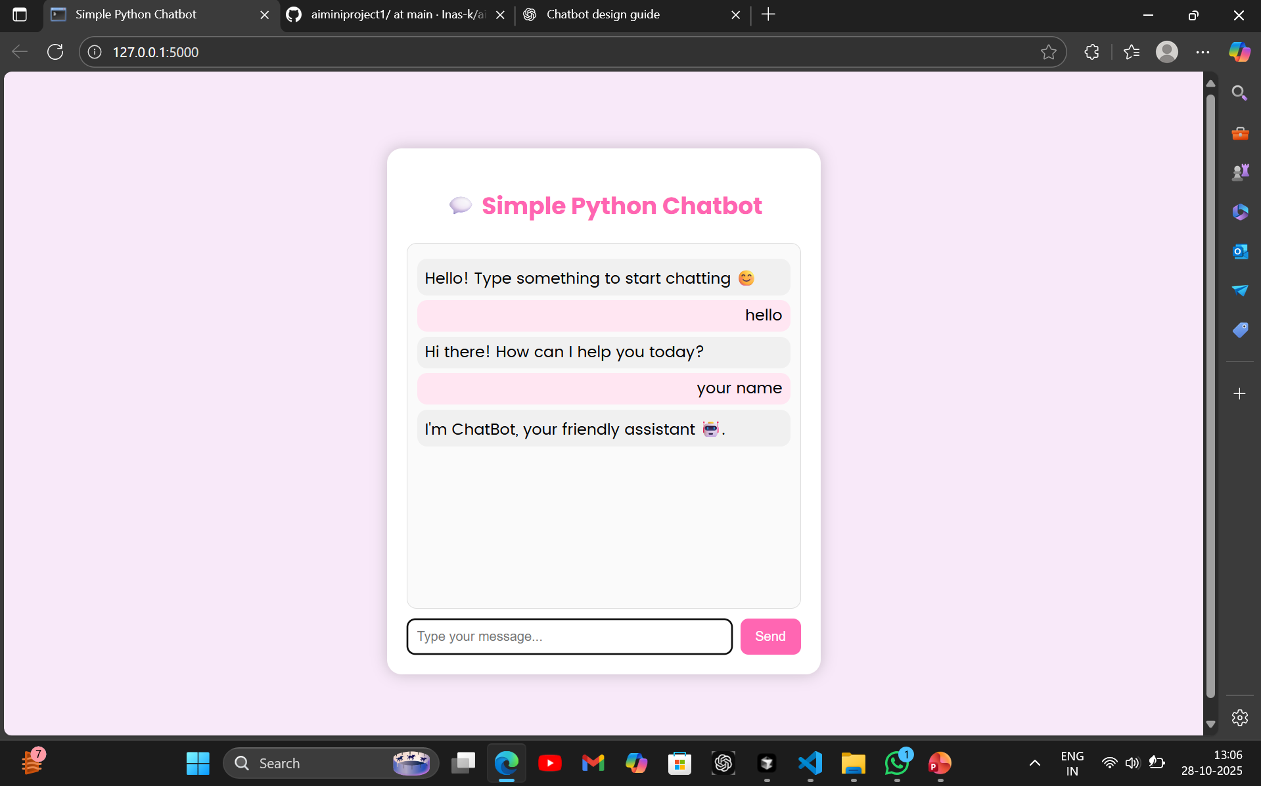
OUTPUT AND RESULTS
Output:
Result:
The chatbot web application was successfully developed using Python (Flask), HTML, and CSS. It responds to user queries in real-time through an interactive and user-friendly chat interface.

Slide 6
REFERENCES
📚 References
Mark Lutz, Learning Python, 5th Edition, O’Reilly Media, 2013.
Miguel Grinberg, Flask Web Development: Developing Web Applications with Python, O’Reilly Media, 2018.
Jon Duckett, HTML and CSS: Design and Build Websites, Wiley Publishing, 2011.
Flask Official Documentation — Pallets Projects Team
W3Schools Online Web Tutorials — HTML, CSS, and JavaScript References

